Slide 1
Mapping Presidential Trends Effects on Market
Oscar Daum Launch Application

Slide 2
Background
Over the past summer, the market has seen a volatile 2nd and 3rd quarter partly due to tariffs imposed on Chinese imports and continued retaliations on both sides. I was interested to see the reflections of the market on the president. How specific social media activity mirrored trends in the market and his overall approval ratings. In this presentation, I dive into several data sets to support my hypothesis that a president's actions/statements can skew the market directly and indirectly through Americans trust in their government leader. I utilize data on the economy, presidential approval ratings, and web-scraped twitter activity to monitor trends.

Slide 3
Approval
approval_pollist.csv
The Data
Economy
Twitter Data
data_csv.csv
Webscraped using Twint

Slide 4
Approval Ratings
01
Market Analysis
02
Let’s Get Started
Twitter Activity
03
Conclusion
04

Slide 5
01
Approval Ratings

Slide 6
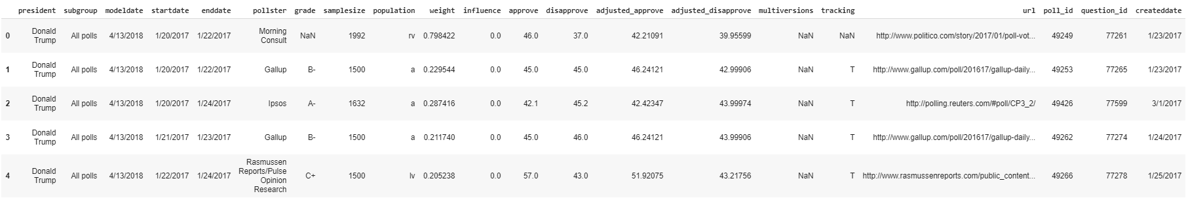
Data Overview/ Data Frame
The data shows data from ~400 polling sites and includes useful information such as approval rates, poll dates, and identification information.

Slide 7
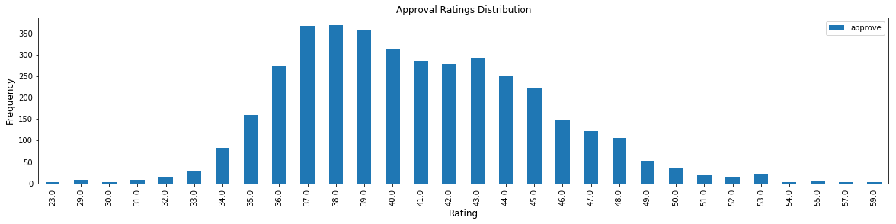
Distribution of ratings over this time

Slide 8
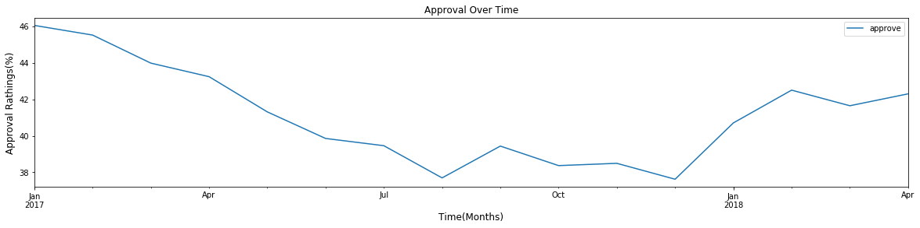
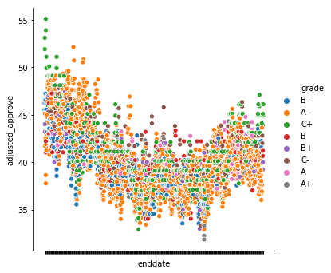
Fluctuations in Approval Over time

Slide 9
Analysis
The data shows a distribution of ratings around 36% to 43% approval. When we compare this to the time trend, we see a dip starting in January 2017 and continuing until August 2017 and rising in September then falling in October. The approval ratings reach their lowest point in December 2017 and rise to 42% until the end of the data time frame in April 2018.
The data reflects volatility, and I am curious as to the effects and causes of such a varying approval rating...

Slide 10
02
Market Analysis

Slide 11
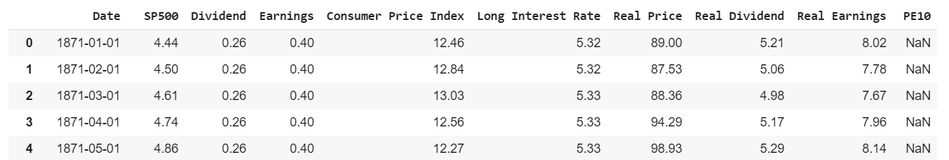
Data Overview/ Data Frame
The data shows various statistics about the S&P index from 1871-2018. I used the S&P as a data set to generalize performance of the overall market/ consumer confidence.

Slide 12
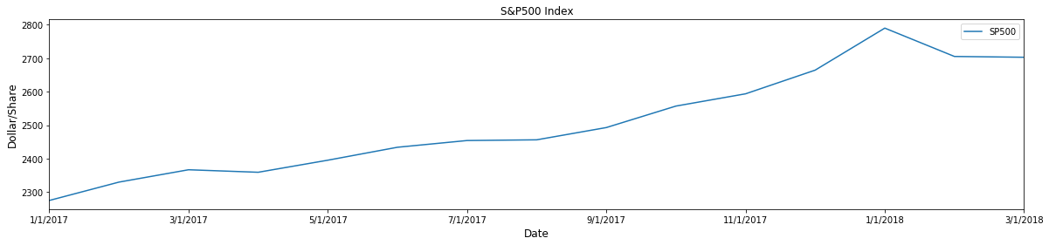
S&P Performance from 1/2017 to 3/2018

Slide 13

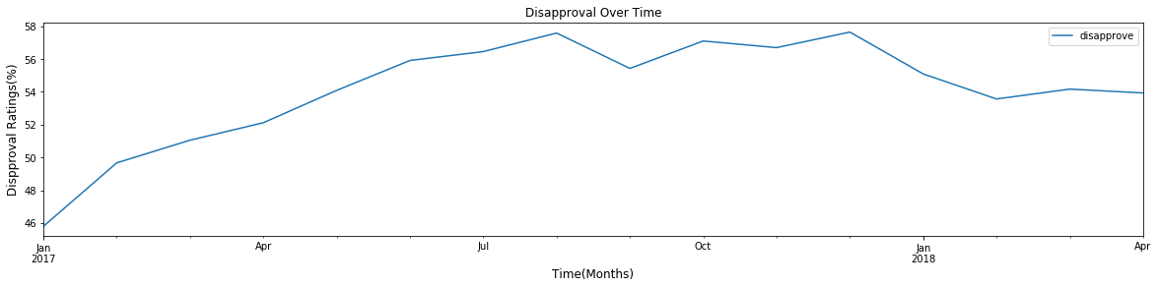
Comparison to Disapproval Ratings

Slide 14
Analysis
Contrary to my hypothesis, It appears that approval rates have an indirect correlation with the market. When the market does well, trumps rating decrease and when the market suffers, his popularity increases. This could potentially be due to the president appearing more active and beneficial to the country when it is in need. I have mirrored the disapproval ratings with the Market analysis to show this correlation.

Slide 15
03
Twitter Activity

Slide 16
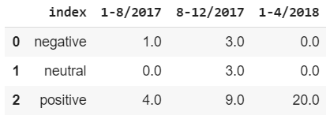
Data Overview/ Data Frame
I web-scraped tweets by Trump where he mentioned “Economy” then ran sentiment analysis on his tweets and turned them into the data frame above. I partitioned the data into three specific timelines that showed a shift, either increase or decrease, in market and approval analysis.

Slide 17
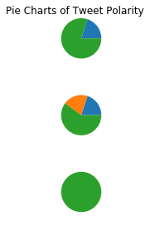
Polarity of Tweets over three time periods
1/1/17 to 8/1/17
KEY
Positive
Negative
Neutral
8/1/17 to 12 /1/17
1/1/18 to 4/1/18

Slide 18

Comparison to Market and Disapproval trends
KEY
Most Neutral
Most Negative
Most Positive

Slide 19
Analysis
The trend of twitter activity over time mirrored with the market and approval analysis paint an interesting narrative. When the market is doing well, the president tweets less and is the most neutral in terms of his sentiment. When the S&P 500 was increasing at the fastest rate, Trump tweeted a bit more; however, his sentiment analysis was more negative relatively speaking. Finally, When the market suffered, the president’s sentiment was only positive and he tweeted about the economy more times than he had over the past 12 months.

Slide 20
04
Conclusion

Slide 21
Final Conclusion
Although the data does not support my initial hypothesis, the data analysis found a different trend/narrative I find interesting. From the data gathered and plotted, I have come to the conclusion that market success correlates inversely with presidential approval. Furthermore, twitter activity by the president is increased and more positive in attitude when when the market suffers. Logically, this would make sense and can paint a narrative that goes something like this. When the market is doing poorly, the president boosts consumer confidence by up-talking the economy and its progress. This morale boost likely includes self promotion in terms of his work improving the economy, thus his approval ratings increase when the market is doing more poorly and his twitter activity is enhanced.

Slide 22
Potential Further Work/ Error
In the future, I would be interested in doing a more comprehensive analysis of the president’s sentiment analysis. For this, I would include more media analysis as well as data from other people’s perspectives on the economy and the president.
There are several aspects of my project process that I can improve. For one, I can find a more comprehensive data set such that I will not need to scrape data or import another data set. Furthermore, I do not yet have access to data from this past year. I feel that market would be more interesting/correlative as it was much more volatile in terms of market and political turmoil.

Slide 23
THANK you for your interest in my project! I hope you enjoyed my findings.

